Slide 1
Singly-Linked List
Topic 2 Discussion 1
Ryan Coon

Slide 2
Singly-Linked List
A linear data structure in which each element of the list contains a pointer that points to the next element in the list.
Each element in the list is called a node.
Each node has two components: data and a pointer which points to the next node in the list.
The first node is called the head and the last node is called the tail.
The last node of the list contains a pointer to the null.
Each node in the list can be accessed linearly by traversing through the list from head to tail.

Slide 3
Singly-Linked List
Consider the above example; node 1 is the head of the list and node 3 is the tail of the list. Each node is connected in such a way that node 1 is pointing to node 2. Node 2 is again pointing to node 3. Node 3 is pointing to null as it is the last node of the list.

Slide 4
Basics
Create a class Node which has two attributes: data and next. Next is a pointer to the next node.
Create another class which has two attributes: head and tail.
addNode() will add a new node to the list:
Create a new node.
It first checks, whether the head is equal to null which means the list is empty.
If the list is empty, both head and tail will point to the newly added node.
If the list is not empty, the new node will be added to end of the list such that tail's next will point to the newly added node. This new node will become the new tail of the list.
a. display() will display the nodes present in the list:
Define a node current which initially points to the head of the list.
Traverse through the list till current points to null.
Display each node by making current to point to node next to it in each iteration.

Slide 5
Iteration
For loop
While loop
Enhanced for loop
Iterator
forEach()

Slide 6
Iterator Example
import java.util.Iterator;
import java.util.LinkedList;
public class LinkedList {
public static void main(String[] args) {
// Creating a LinkedList of Integer Type
LinkedList<Integer> linkedList = new LinkedList<>();
// Inserting some Integer values to our LinkedList
linkedList.add(5);
linkedList.add(100);
linkedList.add(41);
linkedList.add(40);
linkedList.add(7);
// LinkedList after insertions : [5, 100, 41, 40, 7]
// Calling the function to iterate our LinkedList
iterateUsingIterator(linkedList);
}
// Function to iterate the Linked List using Iterator
public static void iterateUsingIterator(LinkedList<Integer> linkedList){
System.out.print("Iterating the LinkedList using Iterator : ");
// Creating an Iterator to our current LinkedList
Iterator it = linkedList.iterator();
// Inside the while loop we check if the next element
// exists or not if the next element exists then we print
// the next element and move to it otherwise we come out
// of the loop
// hasNext() method return boolean value
// It returns true when the next element
// exists otherwise returns false
while(it.hasNext()){
// next() return the next element in the iteration
System.out.print(it.next() + " ");
}
}
}
To iterate the LinkedList using the iterator we first create an iterator to the current list and keep on printing the next element using the next() method until the next element exists inside the LinkedList.
We check if the LinkedList contains the next element using the hasNext() method.
The output of the iterator example will be:
“Iterating the LinkedList using Iterator : 5 100 41 40 7

Slide 7
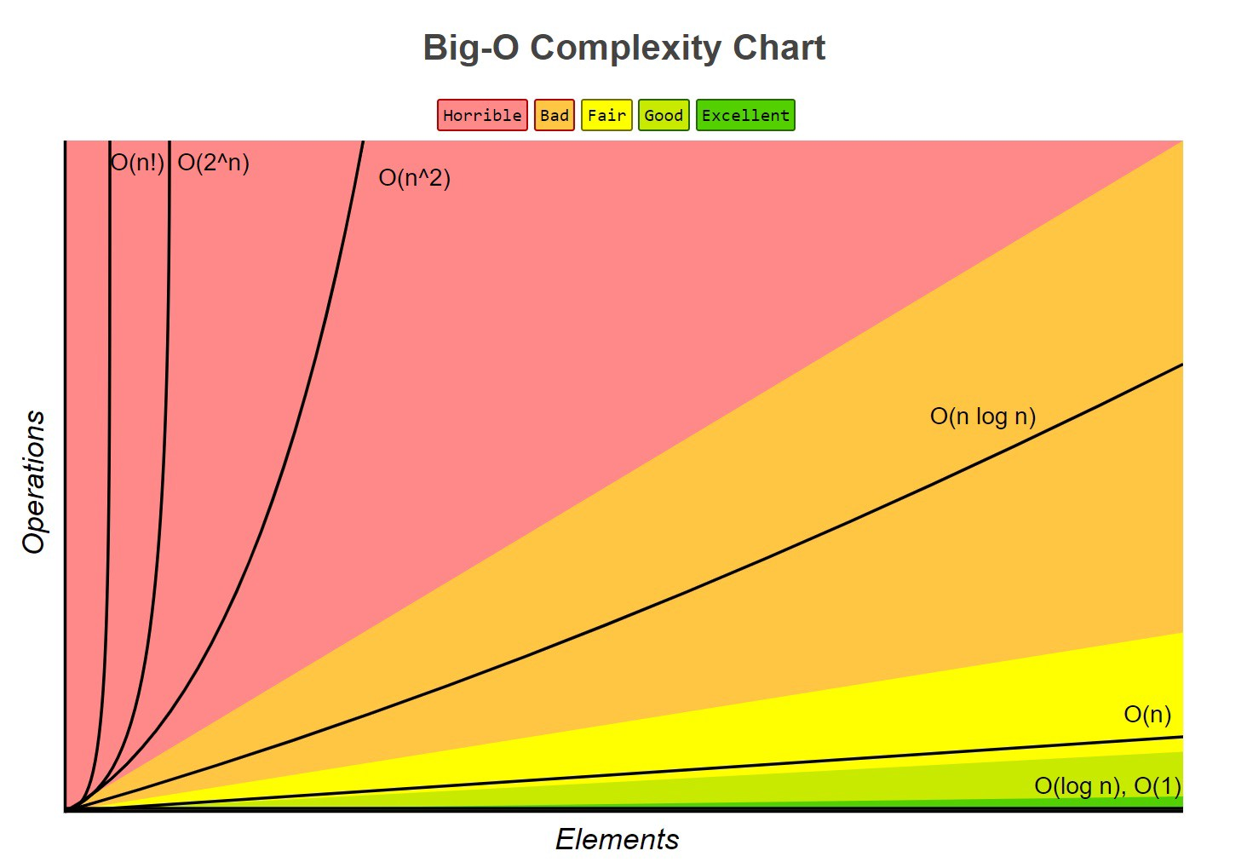
Big-O Analysis
When accessing elements of a linked list, speed is proportional to size of the list with Big O(n). Since we must traverse the entire list in order to get to the desired element, it is more costly compared to accessing elements of an array.
When inserting a node into the beginning of the list, it only involves creating a new node with an address that points to the old head. The time it takes to perform this is not dependent on the size of the list. This means that it will be constant time or a Big O(1).

